Slide 1
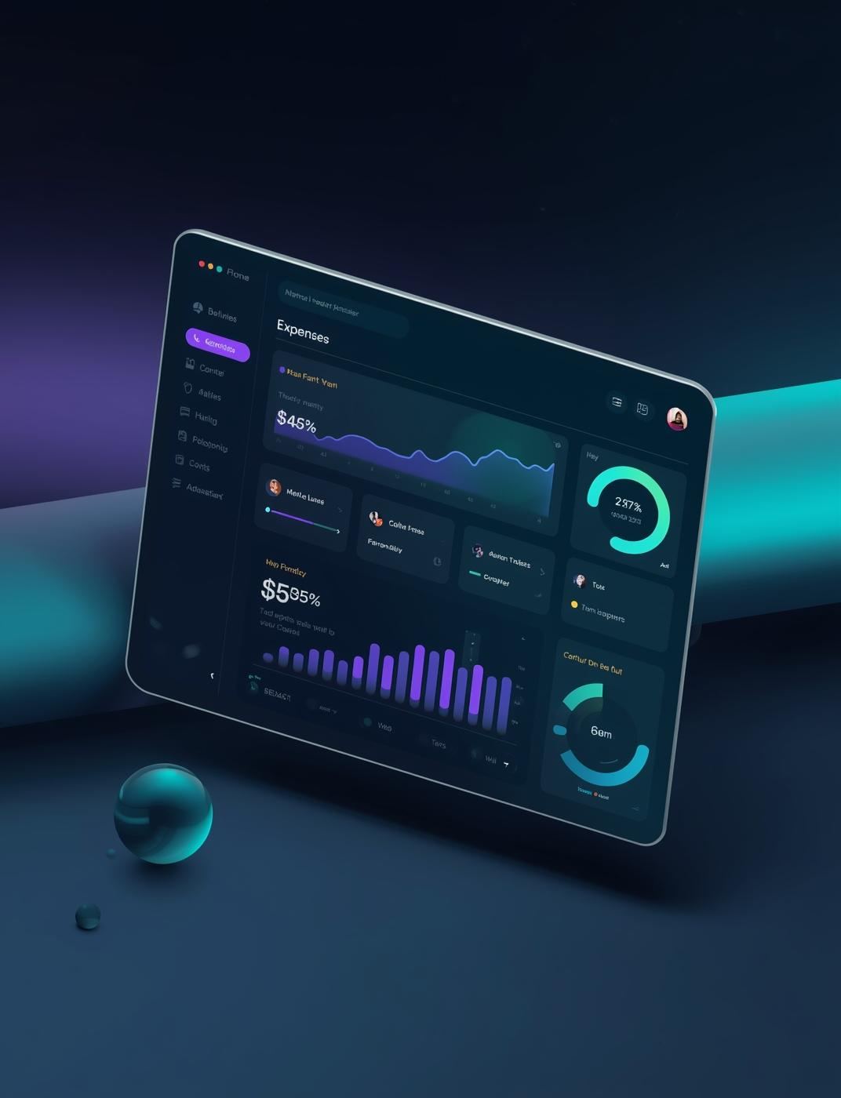
Expense Tracker Website
Web Application Project Overview

Slide 2
Project Overview
01
02
03
Manage Expenses
Category Summary
Visual Insights
Analyze data with pie chart visualizations.
Easily add, edit, or delete expenses.
View expenses grouped by category easily.

Slide 3


Problem Statement
The Challenges of Manual Expense Tracking
Many individuals struggle with manual expense tracking, facing issues such as errors, excessive time consumption, and a lack of insights into their finances. This project aims to address these challenges effectively.

Slide 4

Key Features
Add/Edit/Delete Expenses
Essential functionalities of the Expense Tracker
Easily manage your expenses with full control.
Search Functionality
Quickly find specific transactions using search options.
Filter Options
Organize expenses by categories for better insights.
Export Capability
Download your data in CSV format effortlessly.

Slide 5

Technology Stack Overview
Frontend Technologies
Backend Storage
Visualization Tools
Chart.js is used for data visualization, providing interactive and dynamic charts, while JavaScript enhances functionality and user experience through seamless interactions and real-time updates.
The project utilizes HTML, CSS (featuring a Glassmorphism style for depth), and Bootstrap for responsive design, ensuring a modern and user-friendly interface across devices.
We employ LocalStorage to store user data securely within the browser, allowing offline access and efficient data retrieval without needing a server-side database.

Slide 6
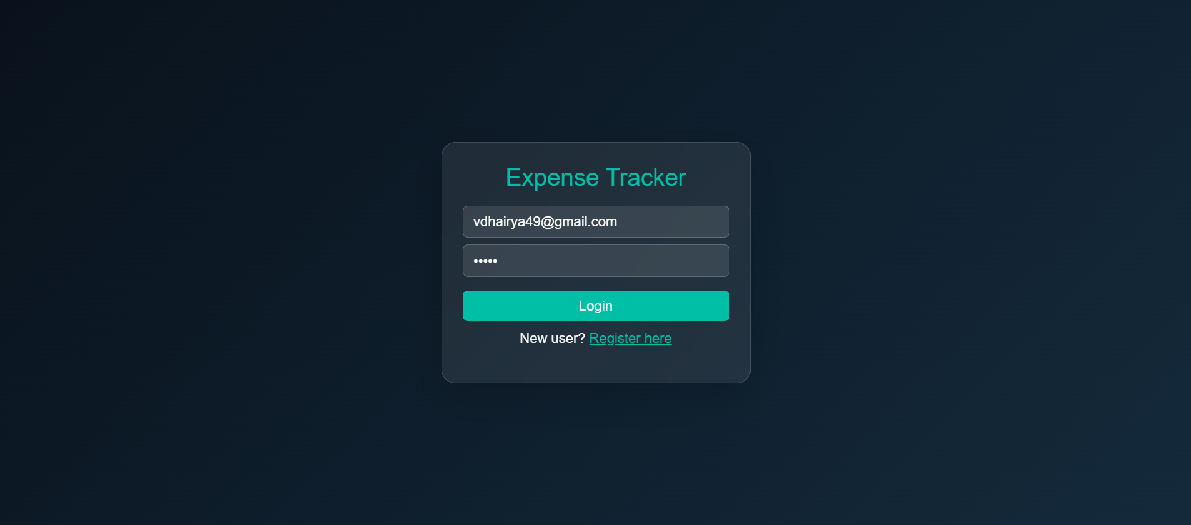
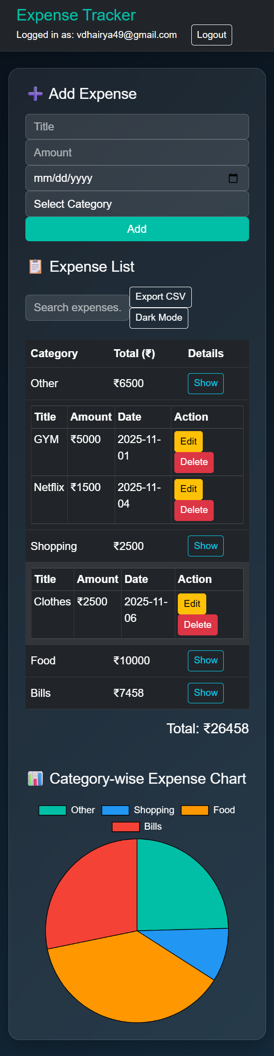

Dashboard Functionality and Expense Management
Add Expense Form
Expense List
User-friendly interface for inputting expenses quickly.
Organized overview of all tracked expenses effectively.

Slide 7
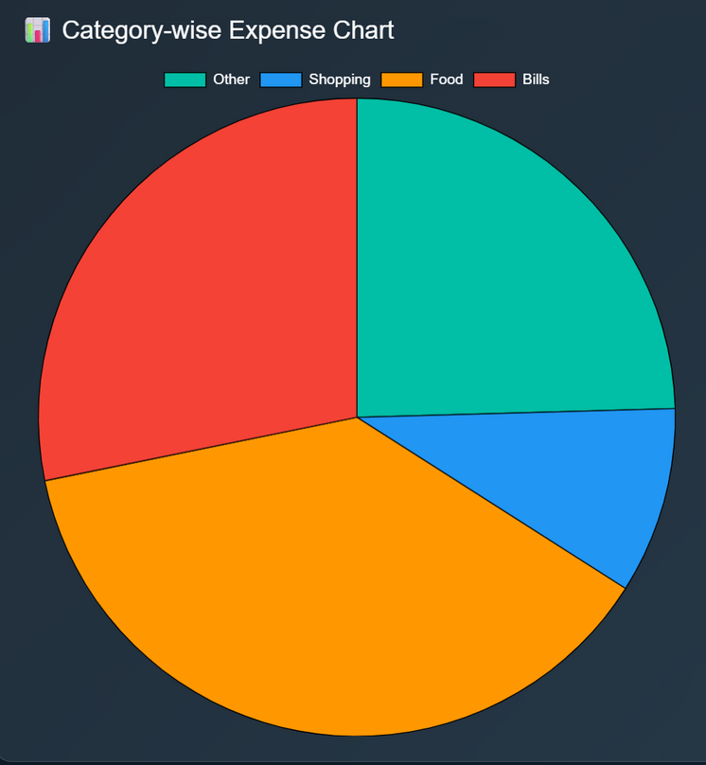
Visual Insights from Expense Dashboard
Pie Chart
Expense Distribution
Visual representation of expenses by category.
Insightful breakdown of spending habits.

Slide 8




Workflow Overview
User Login
Add Expense
Group Expenses
Dynamic Updates
Secure access for users to log in.
Users can easily input and manage expenses.
Expenses are organized by selected categories.
Tables and charts reflect real-time data changes.

Slide 9

Challenges & Solutions
Dropdown Issues
Resolved visibility problems during user interaction.
Addressing common development hurdles effectively
Data Synchronization
Ensured accurate updates for chart data display.
Dark/Light Mode
Successfully implemented seamless theme switching functionality.
User Experience
Enhanced overall usability through consistent design improvements.

Slide 10


Thank You
Name - Dhairya Verma , Vansh Pal
College: Shri Ram Group of Colleges
Course / Semester: e.g., B.Tech CSE – 2nd Year
Mentor - Mr. Vineet Tyagi
Head of Department - Mr. Ashish Chauhan
Role in Project:
Designed and developed the Expense Tracker Dashboard
Implemented HTML, CSS (Glassmorphism), JavaScript, Chart.js
Created responsive design, category-wise charts, and dark/light mode
Skills Highlight:
Web development, UI design, JavaScript, problem-solving

